Slide 1
Algebra 4
Day 69

Slide 2
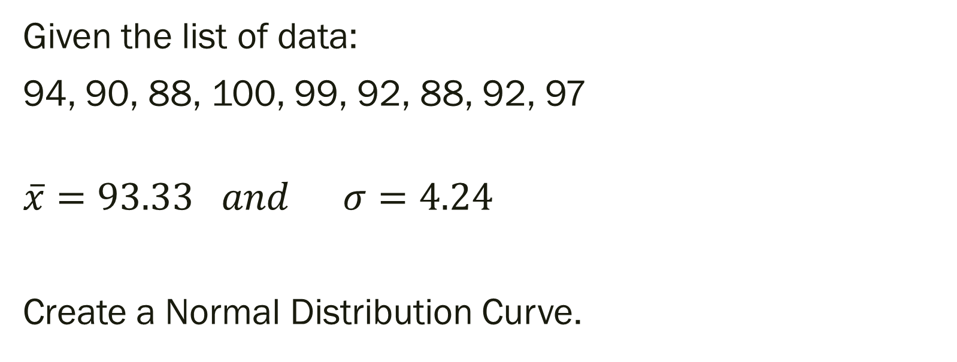
Bell Work
Given the list of data:
94, 90, 88, 100, 99, 92, 88, 92, 97
$$\overline{x}=93.33 and σ=4.24$$
Create a Normal Distribution Curve.

Slide 3
From Last Time
page 743 #2-5, 7-17, 23-28

Slide 4
11.8 Samples and Surveys
Objective: To identify sampling methods
To recognize bias in samples and surveys

Slide 5
Population: all the members of a set
Sample: a part of the population
Convenience Sample: select a member of the population who is readily available Self-Selected Sample: select only members of the population who volunteer for the sample Systematic Sample: order the population in some way and then select from it Random Sample: all members of the population are equally likely to be chosen Bias: a systematic error introduced by the sampling method

Slide 6
For Next Time
page 728 #1-8

Slide 7
Quiz: 53, 55, 42, 38, 47, 50, 47, 40
Level 2:
Mean: _____ Median: _____ Mode: _____ Range: _____
Make Box-and-Whisker Plot
Level 3:
Variance: _____ Standard Deviation: _____
Within how many standard deviations of the mean is the data?
Create and label a Normal Distribution Curve
Level 4:
Is there an outlier? Use the above answers to defend your opinion.

